Slide 1
Collaborative Procedural Content Generation for 2D Platformer
Game Levels
Bradley McFadden

Slide 2
Outline
Introduction
Level design
Procedural content generation
Mixed-initiative systems
Level editor requirements
Methodology
Choosing a suitable generation approach
Level editor improvements
Adding collaborative elements to interaction
Demonstration
Results
Conclusions

Slide 3
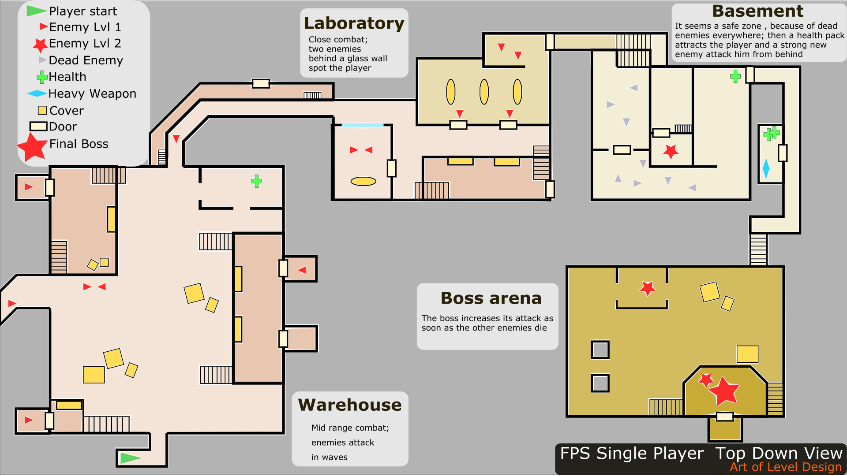
What is level design?
Level designers are like architects, they work with material like AI, terrain, art assets, and game mechanics to create a design that is greater than the sum of its parts.
Super Mario Bros. had no new mechanics introduced after the first level.
Many considerations go into making an interesting level, including pacing, obstacles, and how the level fits into the overall game.

Slide 4
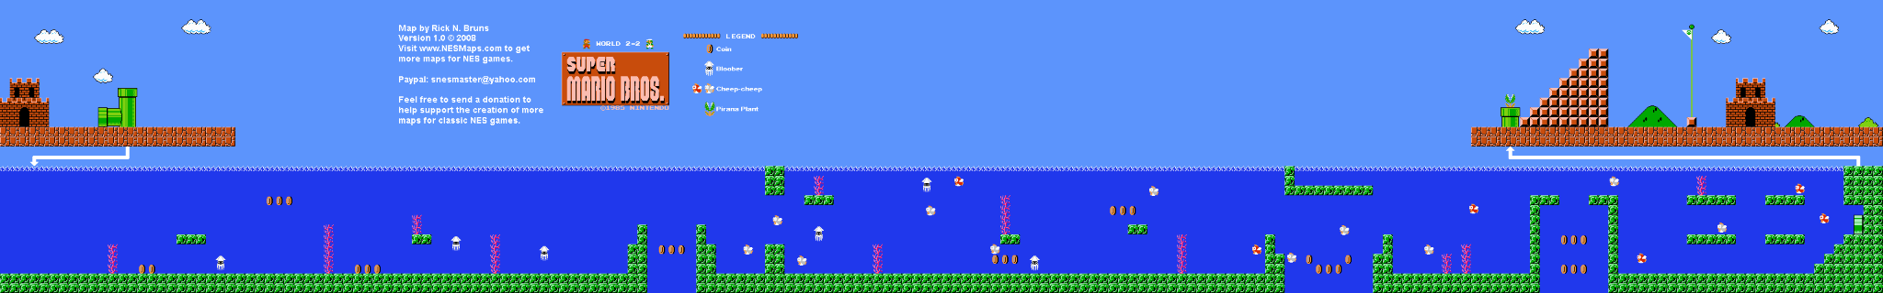
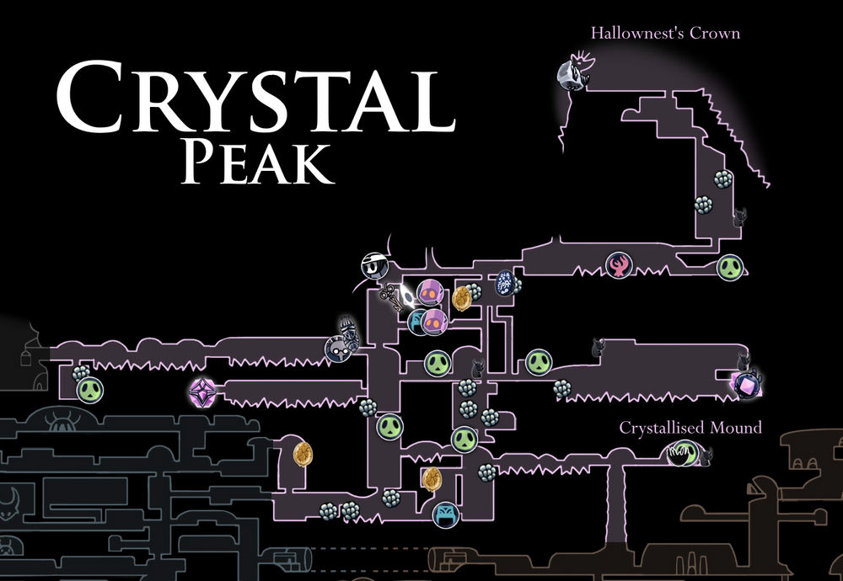
What is level design? (continued)
Unfortunately for designers, levels seem to be getting longer.
Level design is generally slow, requiring a lot of “build & test” stages.
How to evaluate their designs in an efficient manner?

Slide 5
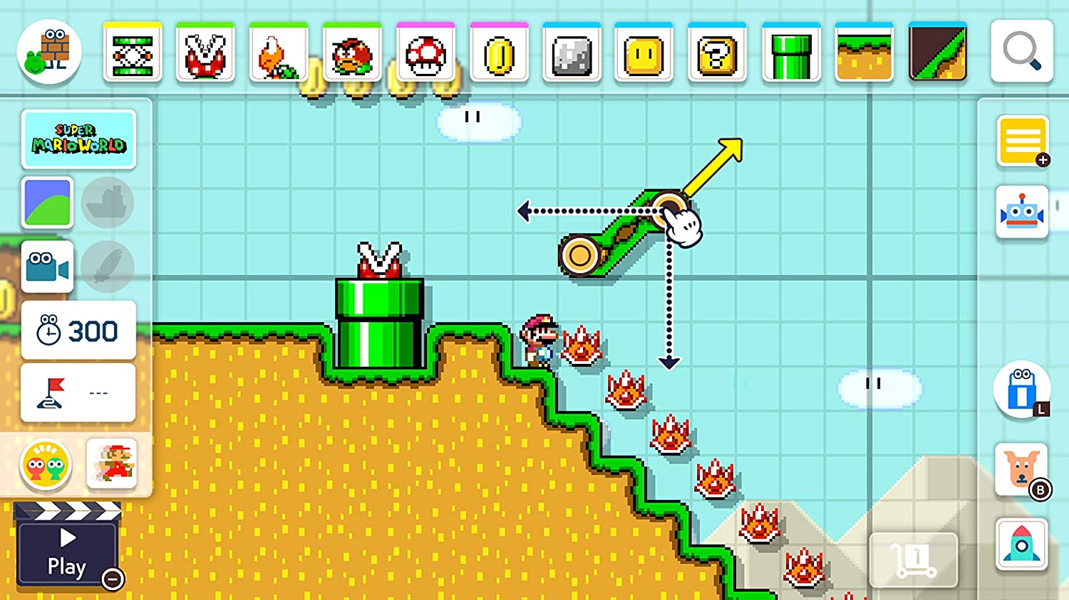
Mario Maker (Nintendo, 2016)

Slide 6
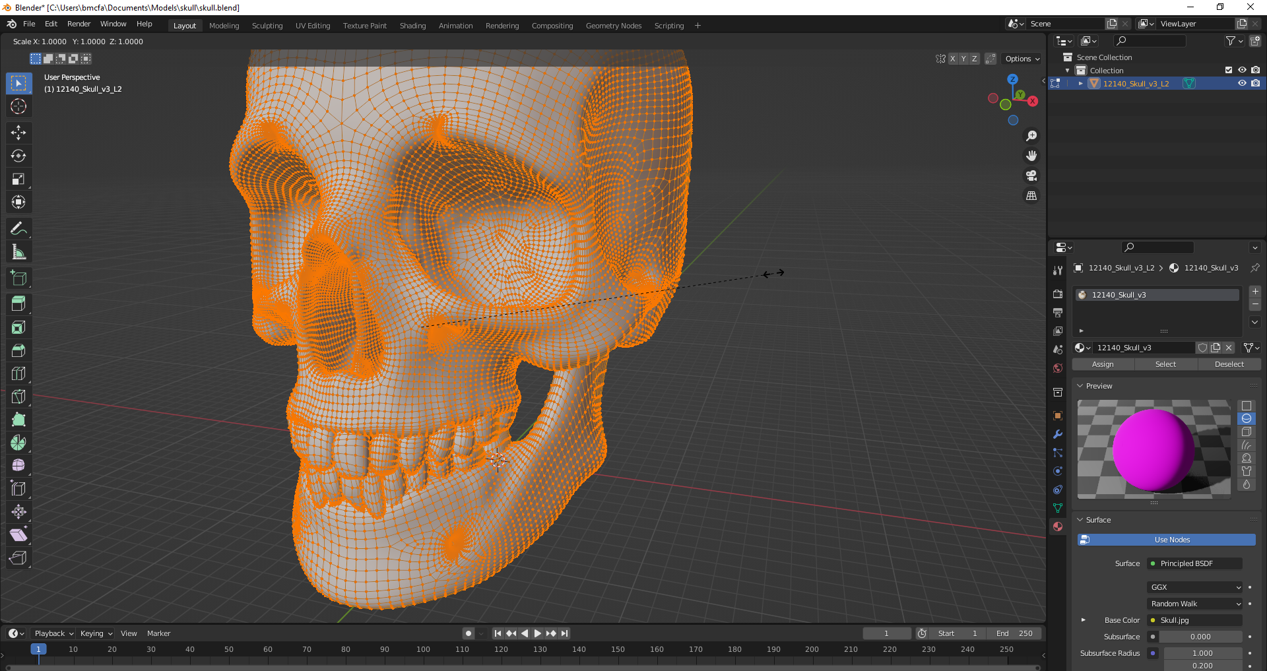
Improving level editing tools
Level editing is a direct manipulation (DM) task.
One of the fundamental characteristics of DM tasks is that feedback should be rapid.
For level geometry, feedback is quickly given.
What about more complicated requirements?
Does the editor provide feedback on the quality of the level?
Can the editor help its designer come up with ideas?

Slide 7
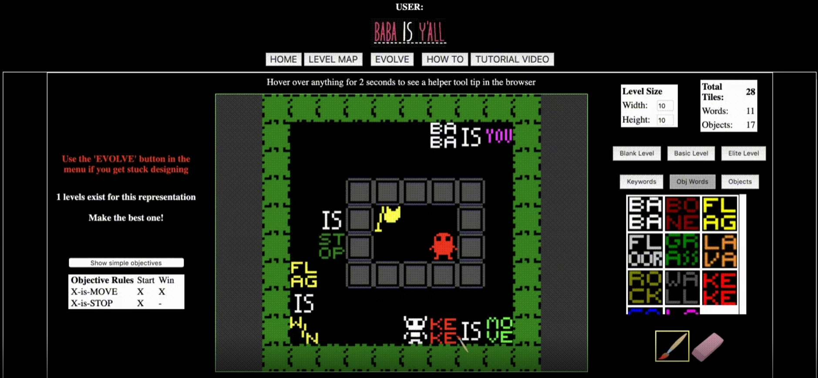
Improving level editing tools (continued)
What if we could create a level editor that more actively helps the designer to create better levels?
To do this, we could:
Use procedural generation techniques
Use techniques of computer-aided design software
Use principles behind making a useful level editor

Slide 8
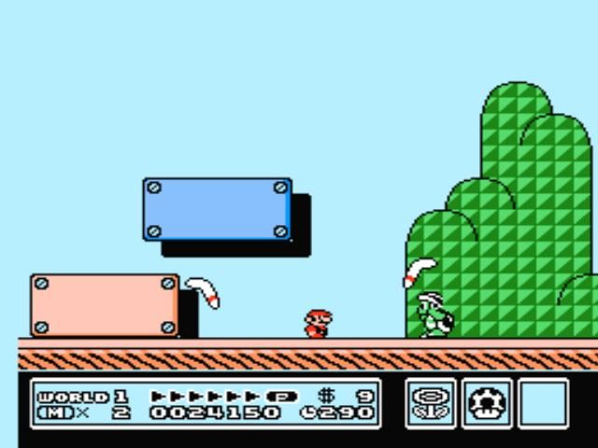
2D Platformer Game Examples
Super Mario Bros. 3

Slide 9
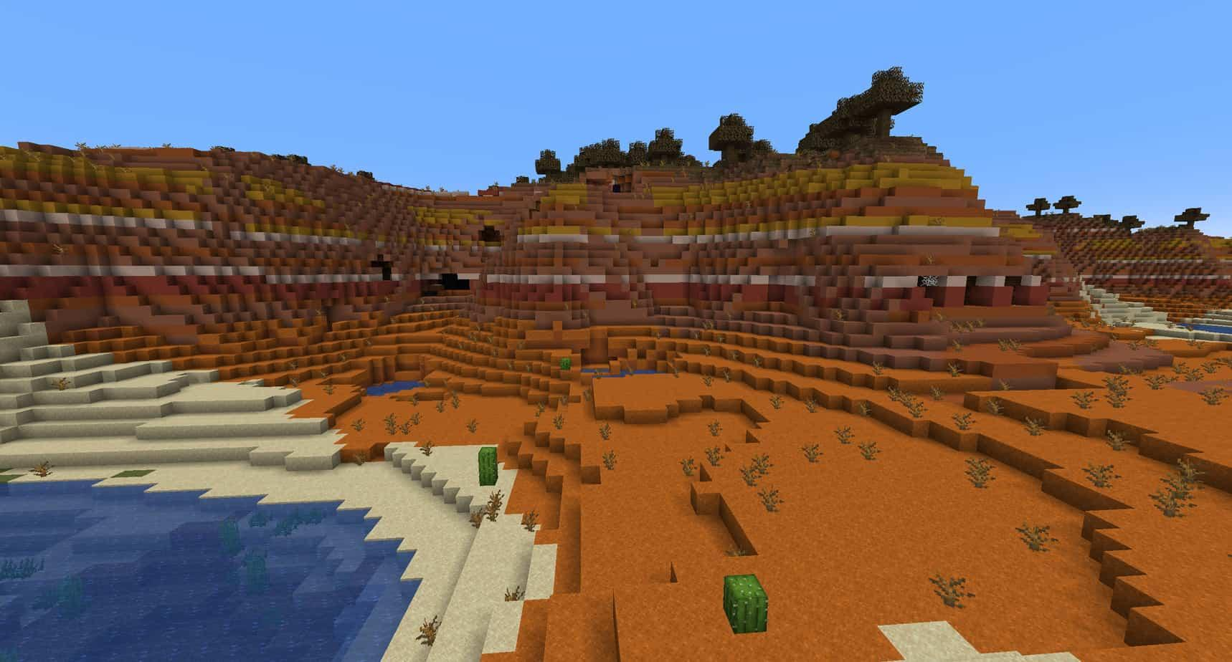
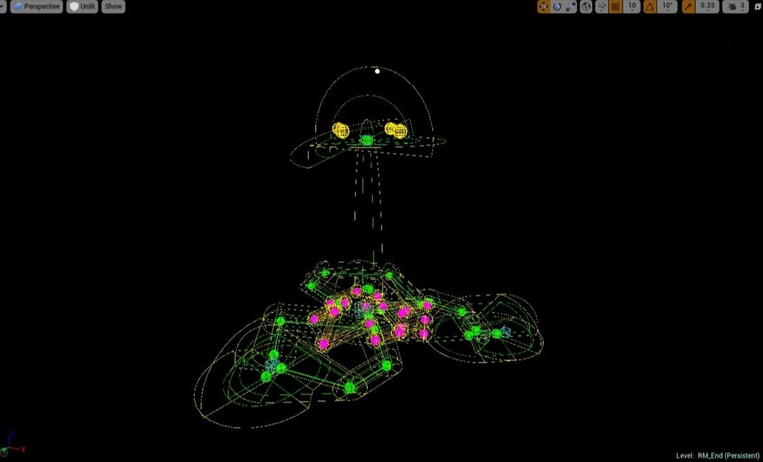
Procedural content generation (PCG)
Refers to the use of procedures to generate some type of game content
Examples include terrain, missions, dungeons, entire worlds, and even entire games.
Can generate content to ensure that each instance is varied, giving a game more replayability.
Note that procedural content generation is done by a program called a procedural content generator (PCG).

Slide 10
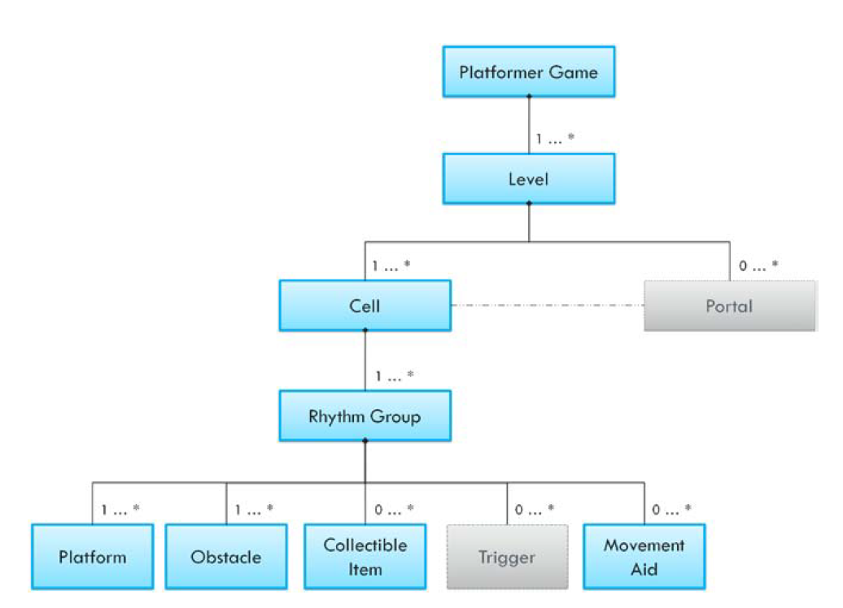
Procedural content generation for platformers
While a grid of tiles may represent how the computer sees a platformer game level, it does not translate to games that do not use this representation.
Instead, a more generic framework can be used.
Compton and Mateas proposed a conceptual model for platformer games.
The model is based on player actions, and is inspired by the rhythm of music.

Slide 11
Rhythm group model
Level
Player spawn, player goal, and cells between
Cell
Linear segment of a level
Rhythm group
Group of player actions with the same rhythm
Beat
An individual player action, like waiting or jumping

Slide 12
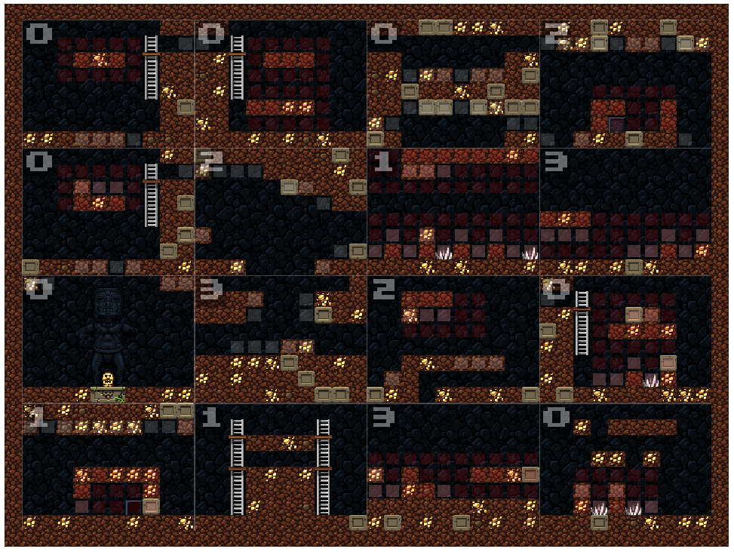
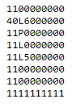
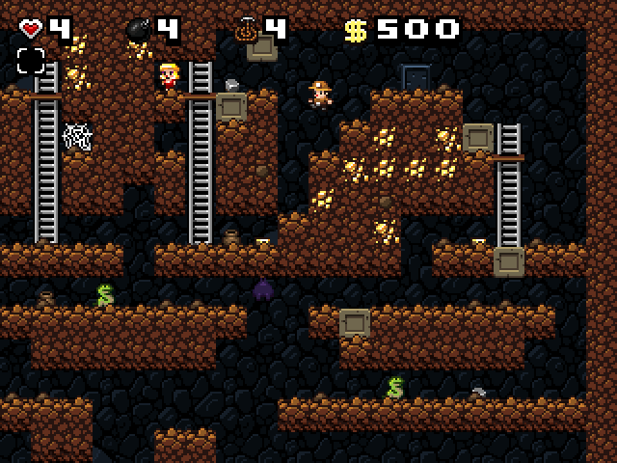
Procedural content generation for platformers (continued)
Several games using PCG implement an approach that connects multiple chunks/rhythm groups together to make a complete level.
Generally, these chunks are human-authored.
Chunks usually use some degree of randomness, to increase the amount of variability in the generated levels.
From Kazemi 2008

Slide 13
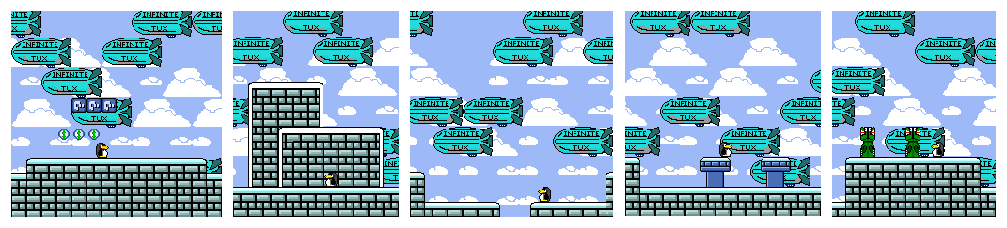
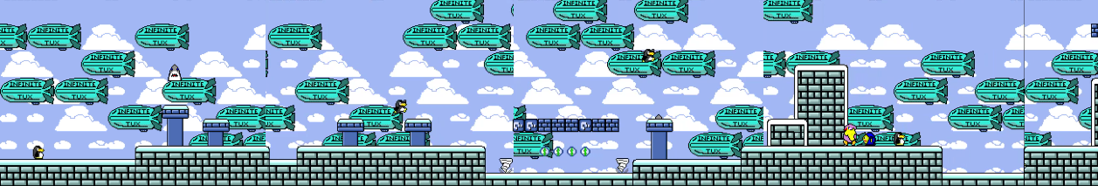
InfiniteTux level generation

Slide 14
Computer-aided design systems taking on a greater role
Systems can provide their users with suggestions to enhance design quality.
For a level editor, imagine if the system provided the user with suggestions for enemy or reward placement based on the existing geometry.
Other possible roles for the CAD system:
nanny - System guides the user through a task.
colleague - System works side-by-side with the user like an equal.
pen-pal - System helps the user communicate their ideas to others.
coach - Computer acts like an expert system, and teaches the user.

Slide 15
CAD systems taking on a greater role (continued)
Systems occupying the colleague and coach roles are also referred to as “mixed-initiative systems”, as both the system and user participate in the design task.
Some CAD systems take more initiative than others.
For example, 3D editing software like Blender allows users to rapidly command the system and create models, but most of the design effort is on the user’s end.

Slide 16
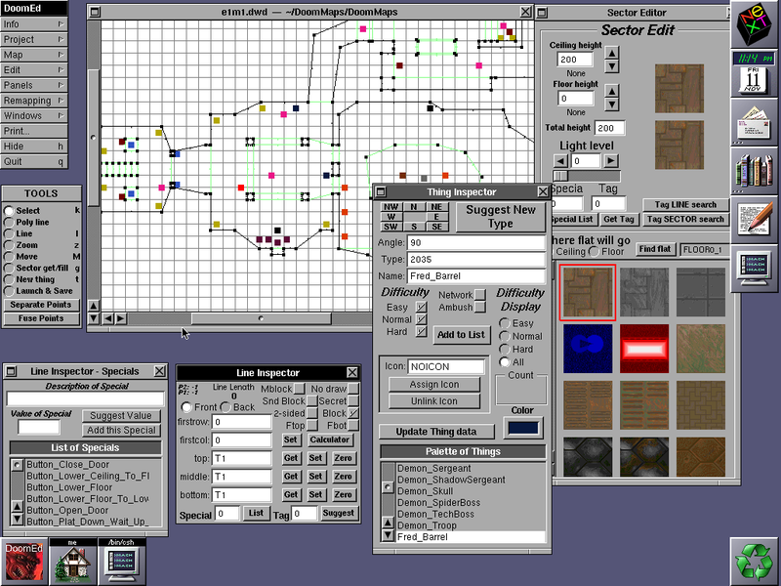
Requirements of level editors
Some special considerations for functionality exist for level editing tools
Level editors should be able to see the world being created.
Level editors should provide the designer with bonus information about the level, which is not normally visible in the game.
Designers should be able to immediately playtest the level.
Full control over all gameplay critical sections of a level.

Slide 17
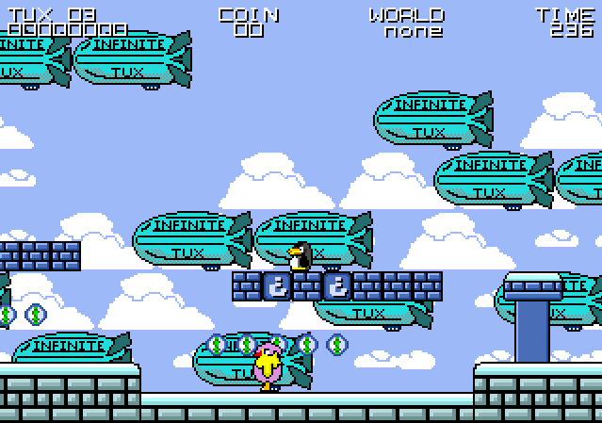
Creating a collaborative level editor
How can a system be designed to assist level designers in creating better levels?
The scope of this system will be limited to the platformer game genre.
The chosen game to implement a level editor for will be InfiniteTux.
The system will support automatic generation of levels, to save the designer work and to provide a brainstorming aid.
The system will also provide some collaborative elements.

Slide 18
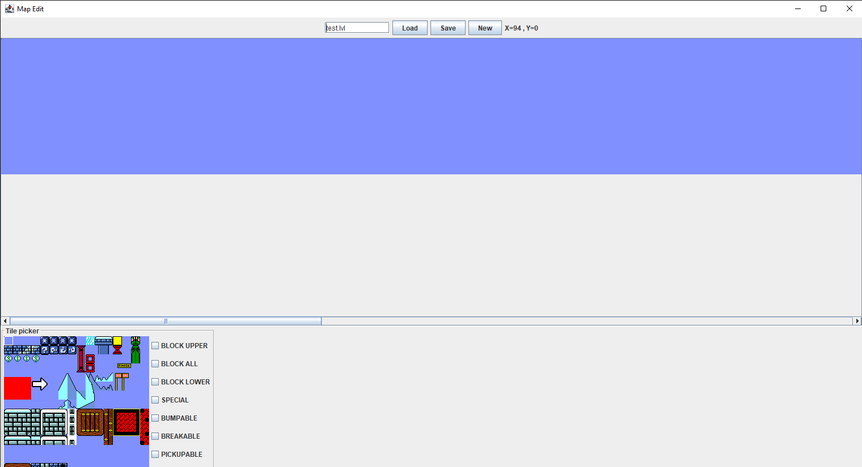
Existing level editor for InfiniteTux

Slide 19
Suitable PCG for an interactive system
The level generator should generate levels quickly.
The PCG is being used as a creative aid, so levels that are output should be quite varied from one another.
The PCG approach should support mixed-authorship.
The designer could optionally be able to configure the system to their needs.

Slide 20
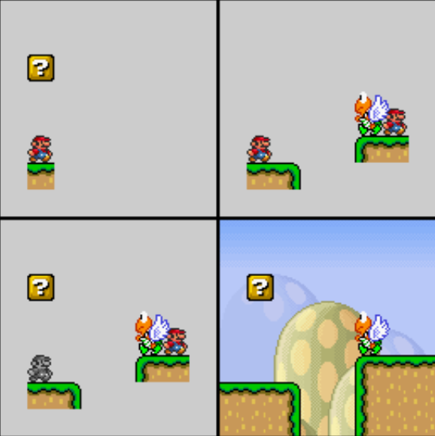
Occupancy Regulated Extension (ORE)
Idea: Allow pre-authored chunks to overlap each other in most spaces, connect by anchor points.
Start from an initial and end platform, overlap chunks until nothing more can be placed without destroying preserved spaces.
Disadvantages: Running time grows with number of anchors and chunks.
From Mawhorter & Mateas 2010

Slide 21
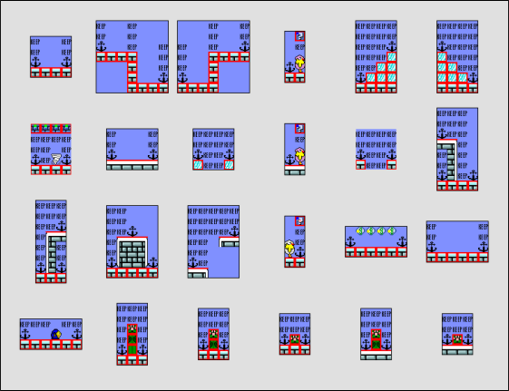
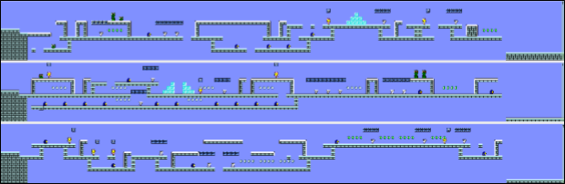
ORE example

Slide 22
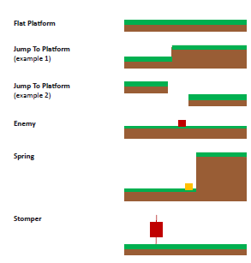
Tanagra
Uses a level generation approach that works off of the beat and rhythm group model.
Generate a beat pattern, use the beat pattern to create matching geometry.
Designer can work in parallel with Tanagra to modify both the beats, and the geometry realizing the beats.
From Smith et al. 2010

Slide 23
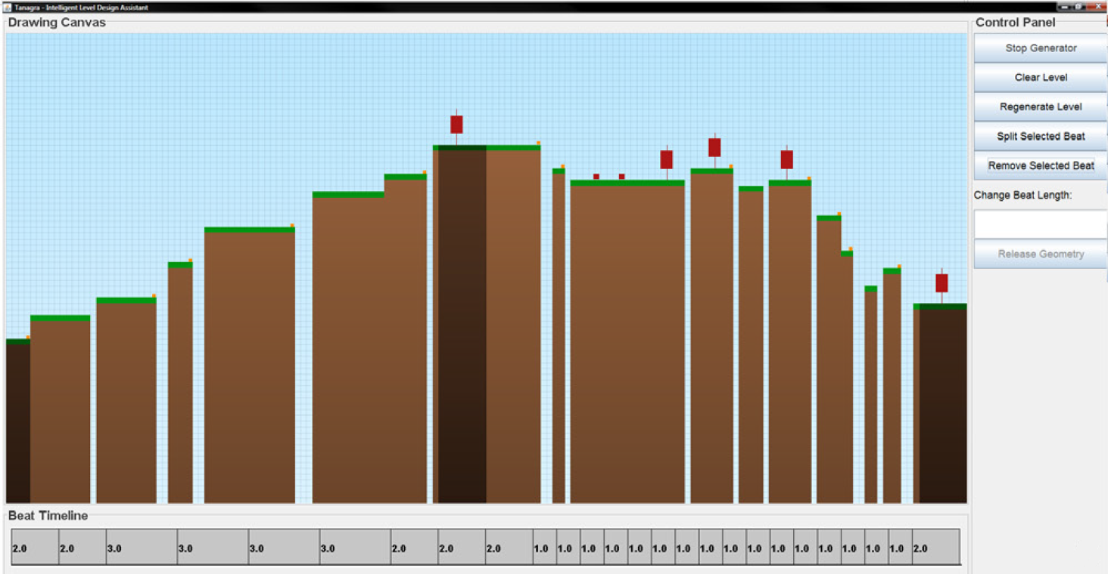
Tanagra example
Images from Smith et al. 2010

Slide 24
Modified ORE
Chunks are small level segments annotated with two special tiles, “preserve points”, and “anchor points”.
Preserve points are spaces which should not be replaced by other chunks.
Anchor points define places where a new chunk can be attached.
Chunks are split into two sets. Chunks marked “place last” are placed in the algorithm’s second pass.
Chunks in the second set are generally chunks that may destroy the level’s ability to expand by consuming an anchor point.

Slide 25
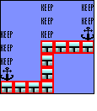
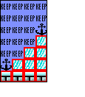
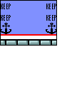
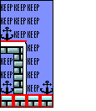
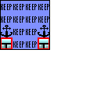
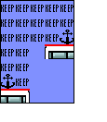

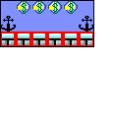
Modified ORE’s Chunks

Slide 26
Improving usability of the level editor
Group operations were added.
Keyboard accelerators were added for most actions.
User can copy and paste parts of a level.
User can undo all actions.

Slide 27
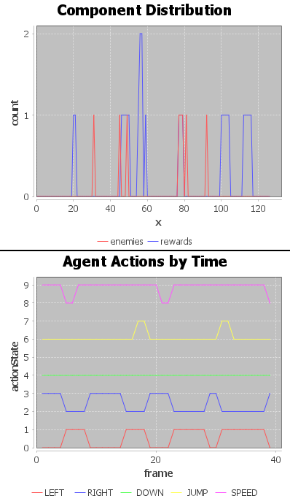
Adding feedback to the level editor (continued)
Changes the user makes are immediately tested by an A* agent, and the user receives immediate feedback in the editor window.
Information about the design itself is also provided through the “System Overview” panel.
Some improvements could be made to system visibility.

Slide 28

Demonstration of final program

Slide 29
Results
Three main goals of the project:
Improve the overall usability of the level editor.
Incorporate a procedural content generator than generates sufficiently varied levels, and allows mixed-authorship.
Produce a collaborative system for level editing.

Slide 30
Improving usability of the level editor
Efficiency improved through shortcuts, by adding the PCG system to the editor, and bulk operations.
Generating ideas may speed up the process of generating a level as well, so some design effort was saved.
Feedback improved through collaborative elements.
Generating a level takes a few seconds, but no progress bar is given.
No help or documentation is provided wrt how the level generation algorithm works, and it is not obvious how it works to a new user.

Slide 31
Determining the suitability of the chosen PCG
Performance is good, but is proportional to the size of chunk library.
The software seems to allow a high-degree of author participation.
The user can have the generator act on a subset of the level, or the entire level.
The generator allows the user to modify its output after running.

Slide 32
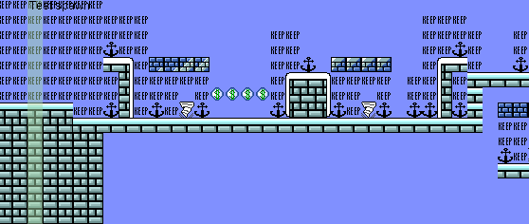
Determining the suitability of the chosen PCG (continued)
The level is split into unique rectangles of a certain size, and a discrete probability distribution is created from these unique pieces.
Using Kullback-Leibler Divergence, two levels can be compared to each other by comparing their probability distributions.

Slide 33
Experiment to measure mORE’s level variation
A level generator was included with InfiniteTux that uses 5 chunks types with random minor variations, and a post-processing step.
mORE was compared against this default generator.
10,000 pairs of levels were created, and their KL-divergence was collected.
If mORE creates more varied levels than the default generator, then its mean KL-divergence should be higher.
This experiment was conducted using KL-divergence with 2x2, 4x4, and 6x6 feature sizes.

Slide 34
InfiniteTux level generation

Slide 35
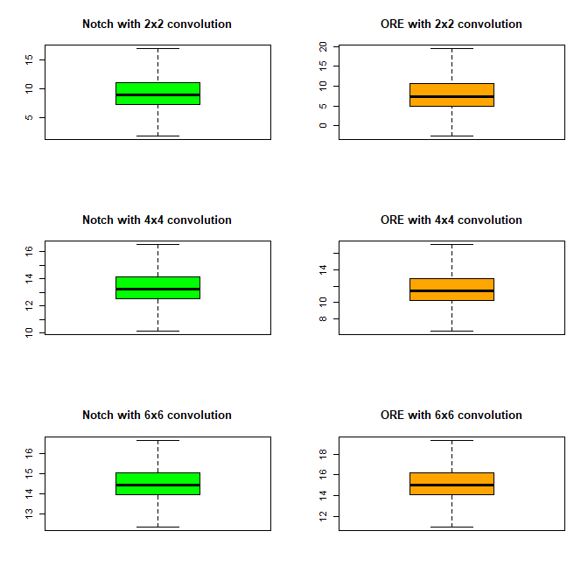
Experiment to measure mORE’s level variation
Generator and Feature Size | Q1 | Median | Mean | Q3 | s
Notch 2x2 | 7.220 | 8.982 | 9.431 | 11.138 | 3.213
mORE 2x2 | 4.830 | 7.276 | 9.768 | 10.641 | 14.680
Notch 4x4 | 12.507 | 13.253 | 13.394 | 14.111 | 1.286
mORE 4x4 | 10.211 | 11.419 | 12.282 | 12.972 | 6.162
Notch 6x6 | 13.950 | 14.450 | 14.540 | 15.030 | 0.871
mORE 6x6 | 14.080 | 15.030 | 15.510 | 16.190 | 4.119

Slide 36
Experiment to measure mORE’s level variation (continued)
Distribution 1 | Distribution 2 | T-value of single tail upper t-test | Degrees of freedom | p-value
mORE 2x2 | Notch 2x2 | 2.2438 | 10955 | 0.01243
mORE 4x4 | Notch 4x4 | -17.678 | 10868 | 1
mORE 6x6 | Notch 6x6 | 23.038 | 10891 | 2.20E-16
Results of significance testing with confidence interval of 0.95
mORE produces more varied 2x2 and 6x6 features.
We cannot conclude whether or not mORE produces more varied 4x4 features over the default generator.
mORE likely produces more varied features because it works with a larger library of content, and allows chunks to overlap one another.
The variation in the default generator comes from minor random variation within the placed chunks.

Slide 37
Evaluating the level editor as a collaborative system
Provides user the ability to configure level editor input.
Flexible amount of support for mixed-authorship.
User must command the system about where to act, but cannot command what it does.
The user has to interpret the data that the system provides, and depending on their expertise, it varies in usefulness.
The system should incorporate specific, actionable suggestions.
By usability principles, actionable recommendations are more helpful than error messages.

Slide 38
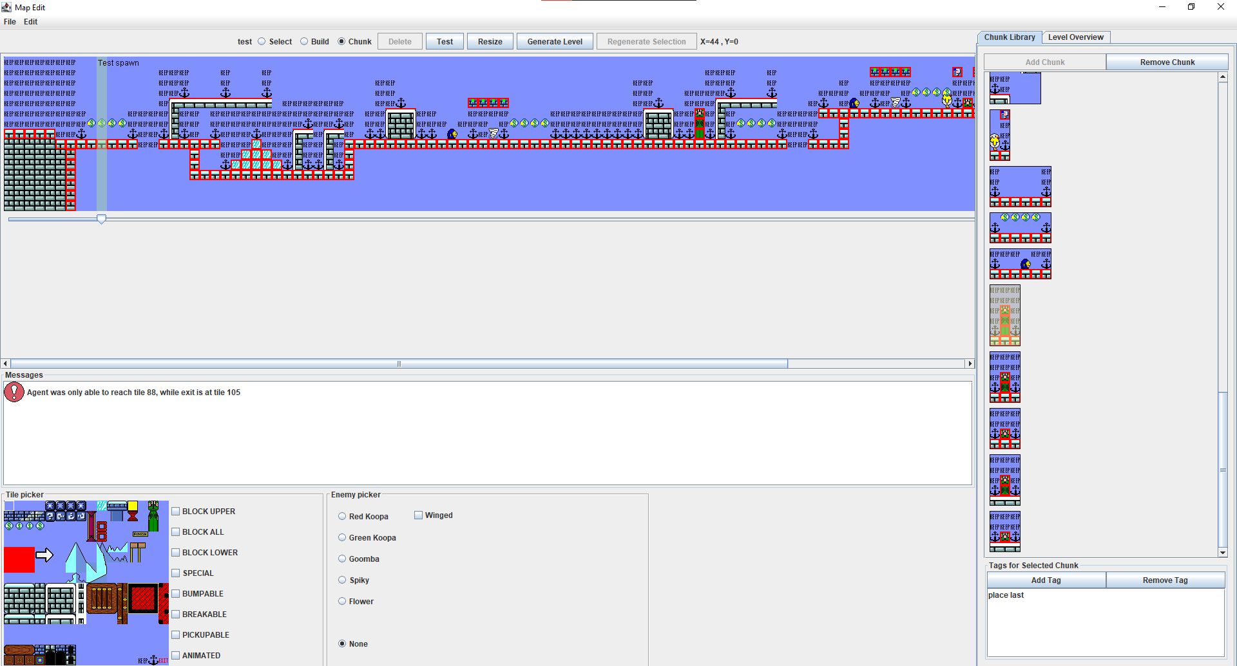
Conclusions
There is a need in game design for improving level design tools.
Many different approaches exist to procedural content generation.
The goal behind this project was to use procedural content generation to create an improved system for level editing.
A modified version of ORE was created for the PCG implementation.
Extra information was given to the user by automatically testing their levels, and level overview plots.

Slide 39
Conclusions
PCG can be used in a mixed-initiative system to provide a means for the system to participate in level creation.
It’s possible to provide a customizable PCG in an interactive system.
Mixed-initiative systems can reduce the amount of design effort.
Using a PCG generation approach that overlaps content leads to greater variation of levels compared to a chunk-based approach with minor random variations.
Collaborative elements like the system providing information and commenting on the level playability can save designers some effort.

Slide 40
Thank you for listening to my presentation!

Slide 41
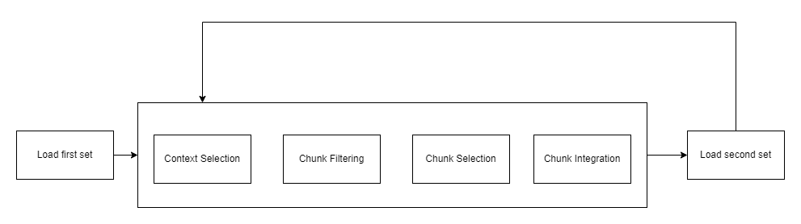
Modified ORE algorithm

Slide 42
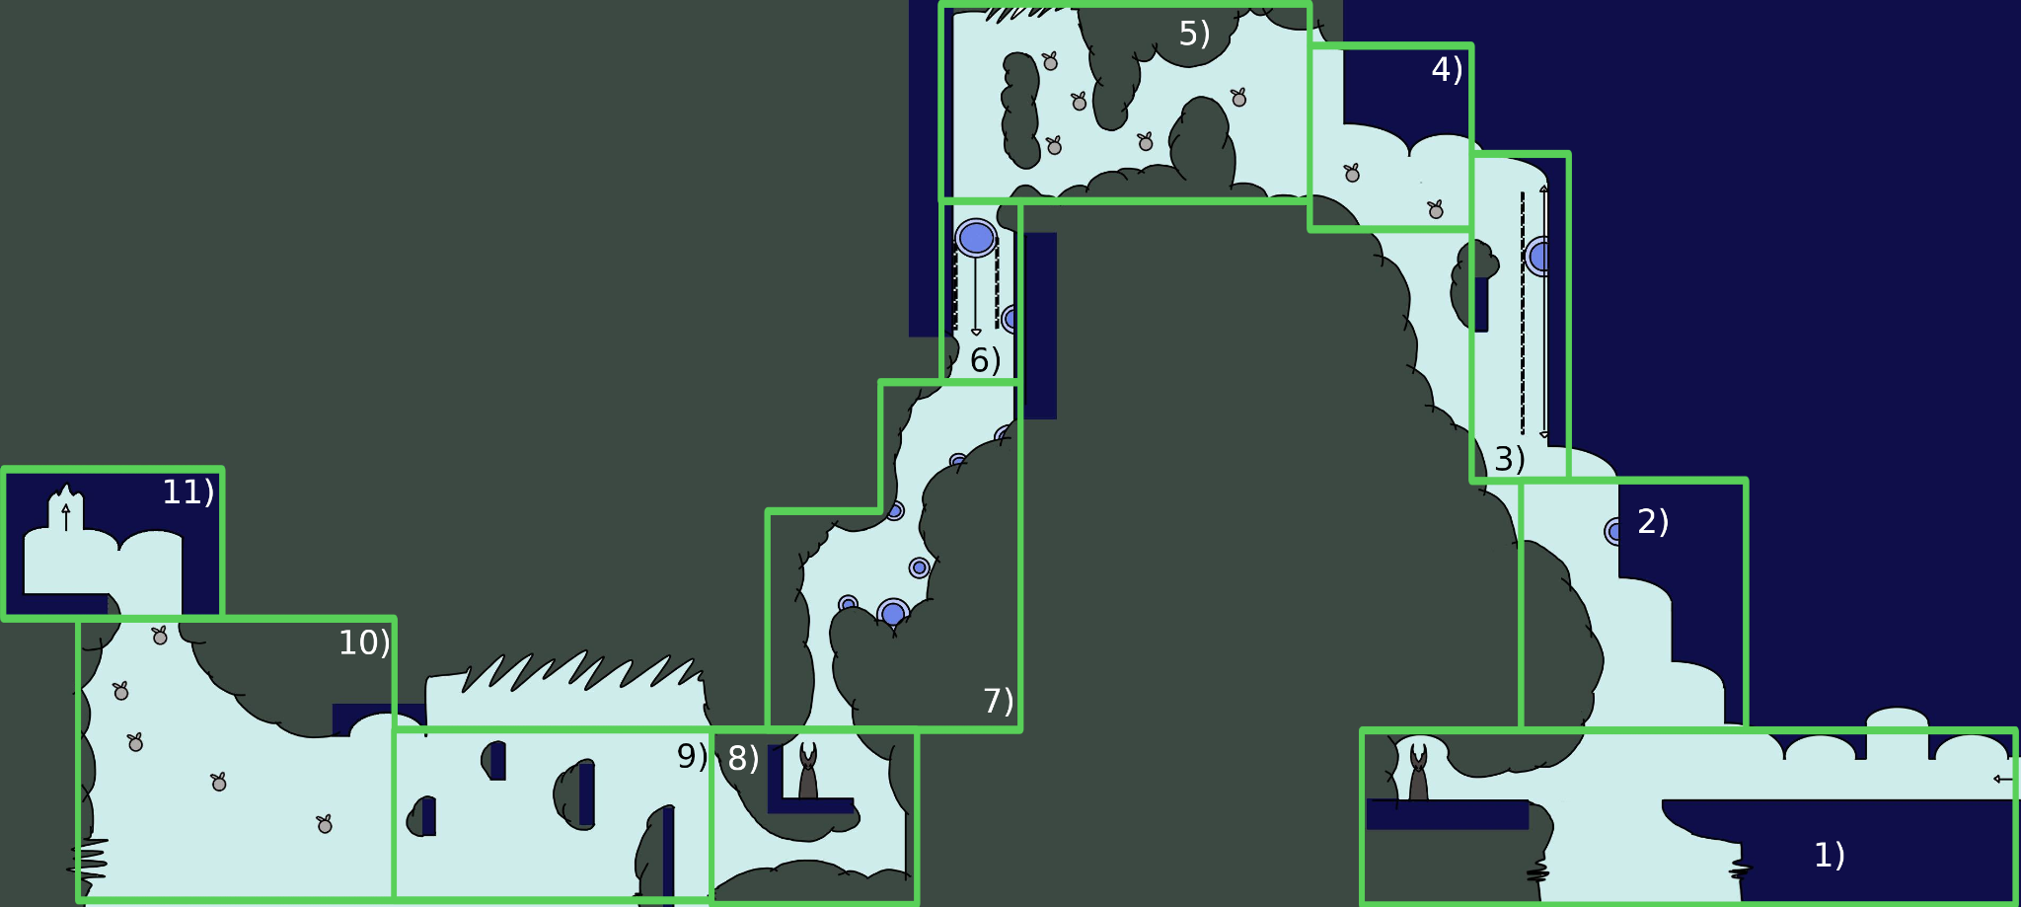
Rhythm group example

Slide 43
Chunk library

Slide 44
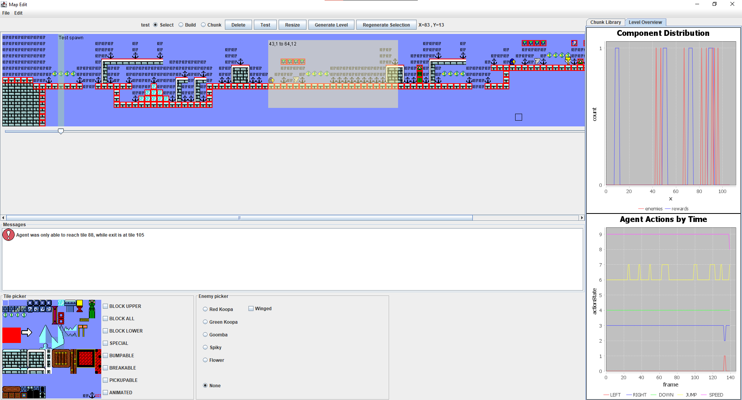
Level overview

Slide 45
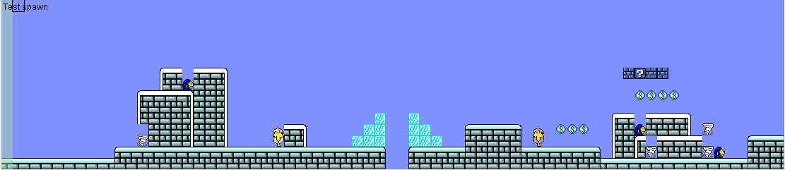
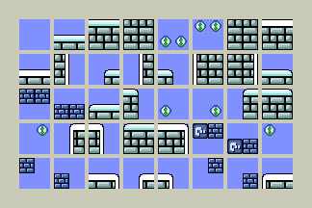
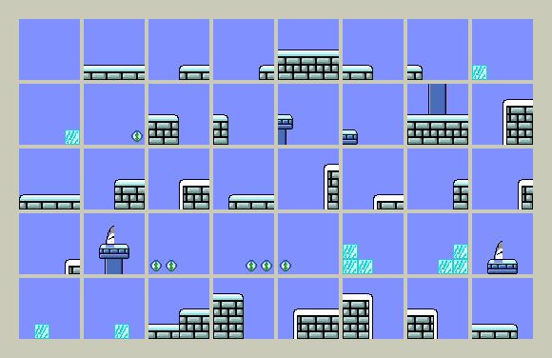
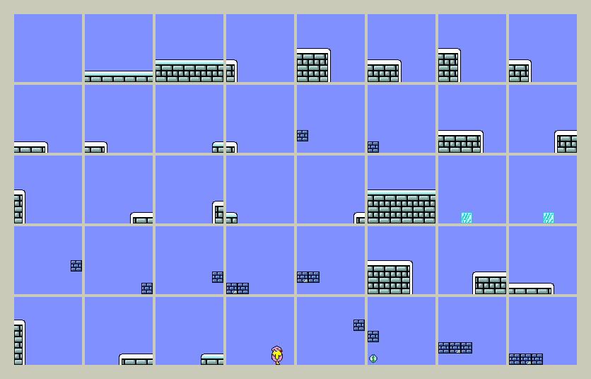

Slide 46
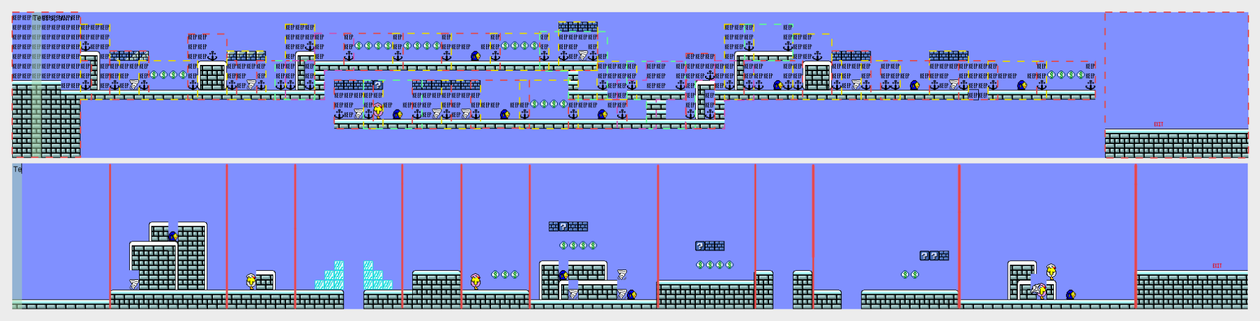
Experiment to measure mORE’s level variation (continued)

